Slide 1
Bits, Bytes, Ints
Jinyang Li
Some are based on Tiger Wang’s slides

Slide 2
Lesson plan
How computers represent integers
Bit, Byte
Hex notation
How computers add/subtract integers
Unsigned vs. signed integer representation

Slide 3
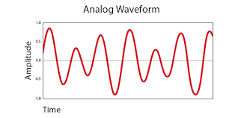

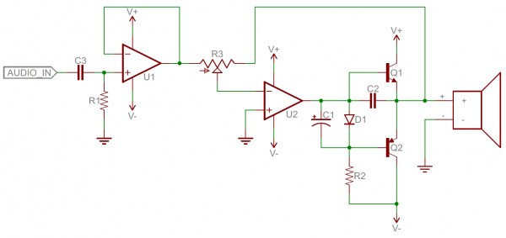
The language of technology has evolved from analog signals…
Analog signals: smooth and continuous
Hard
Difficult to design
Susceptible to noise
Analog components: resistors, capacitors, inductors, diodes, etc.

Slide 4
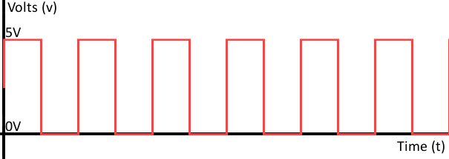

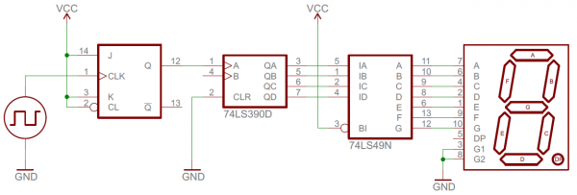
… to digital
1 0 1 0 1 0 1 0 1 0 1 0
Digital signals: discrete (0 or 1)
Easier
Easier to design
Robust to noise
Digital components: transistors, logic gates …

Slide 5
Using bits to represent everything
Bit = Binary digit, 0 or 1
A bit is too small to be useful
A bit has 2 values; the English alphabet has 26 values (characters)
Idea: use a group of bits
different bit patterns represent different “values”

Slide 6
Question
How many bit patterns can a group of 2 bits have?
Can be
either 0 or 1
b₁
b₀
All patterns of 2-bits: 00, 01, 10, 11
How many bit patterns does a group of n bits have?
b_{n-1}b_{n-2}...b₁b₀
# of patterns of n-bits: 2^{n}
n bits

Slide 7
Digression: Any self-respecting CS person must memorize powers of 2
2⁰ = 1
2¹ = 2
2² = 4
2³ = 8
2⁴ = 16
2⁵ = 32
2⁶ = 64
2⁷ = 128
2⁸ = 256
2⁹ = 512
2¹⁰ = 1024

Slide 8
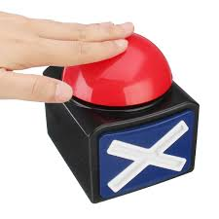
2⁵

Slide 9
2⁸

Slide 10
Approximations of powers of 2
2¹⁰ = 1024
≈
10³ (Kilo)
≈
2²⁰
10^{3*2} = 10⁶ (Mega)
≈
2³⁰
10^{3*3} = 10⁹ (Giga)
≈
2⁴⁰
10^{3*4} = 10¹² (Tera)
≈
2⁵⁰
10^{3*5} = 10¹⁵ (Peta)

Slide 11


≈ 2??

Slide 12
Represent non-negative integer
unsigned
bits: b_{n-1}b_{n-2}…b₂b₁b₀
Goal: map each bit pattern to an integer in [0, ??]
[0, 2^{n} -1]
Example: n=2 → 4 bit patterns in total
_{00,} _{01,} _{10,} 11 can represent integers in [0,3]

Slide 13
Represent unsigned integer
Bit pattern: b_{n-1}b_{n-2}…b₂b₁b₀
What integer does it represent?
Solution: Base-2 representation
b_{n-1}b_{n-2}…b₂b₁b₀ =
b_{i} is bit at i-th position (from right to left, starting at i=0)

Slide 14
Examples
Bit pattern: 00000110
Value: 0*2⁷+0*2⁶+0*2⁵+0*2⁴+0*2³+1*2²+1*2¹+0*2⁰ = 6
Bit pattern: 10000110
Value: ?

Slide 15
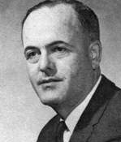
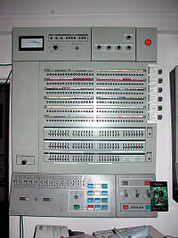
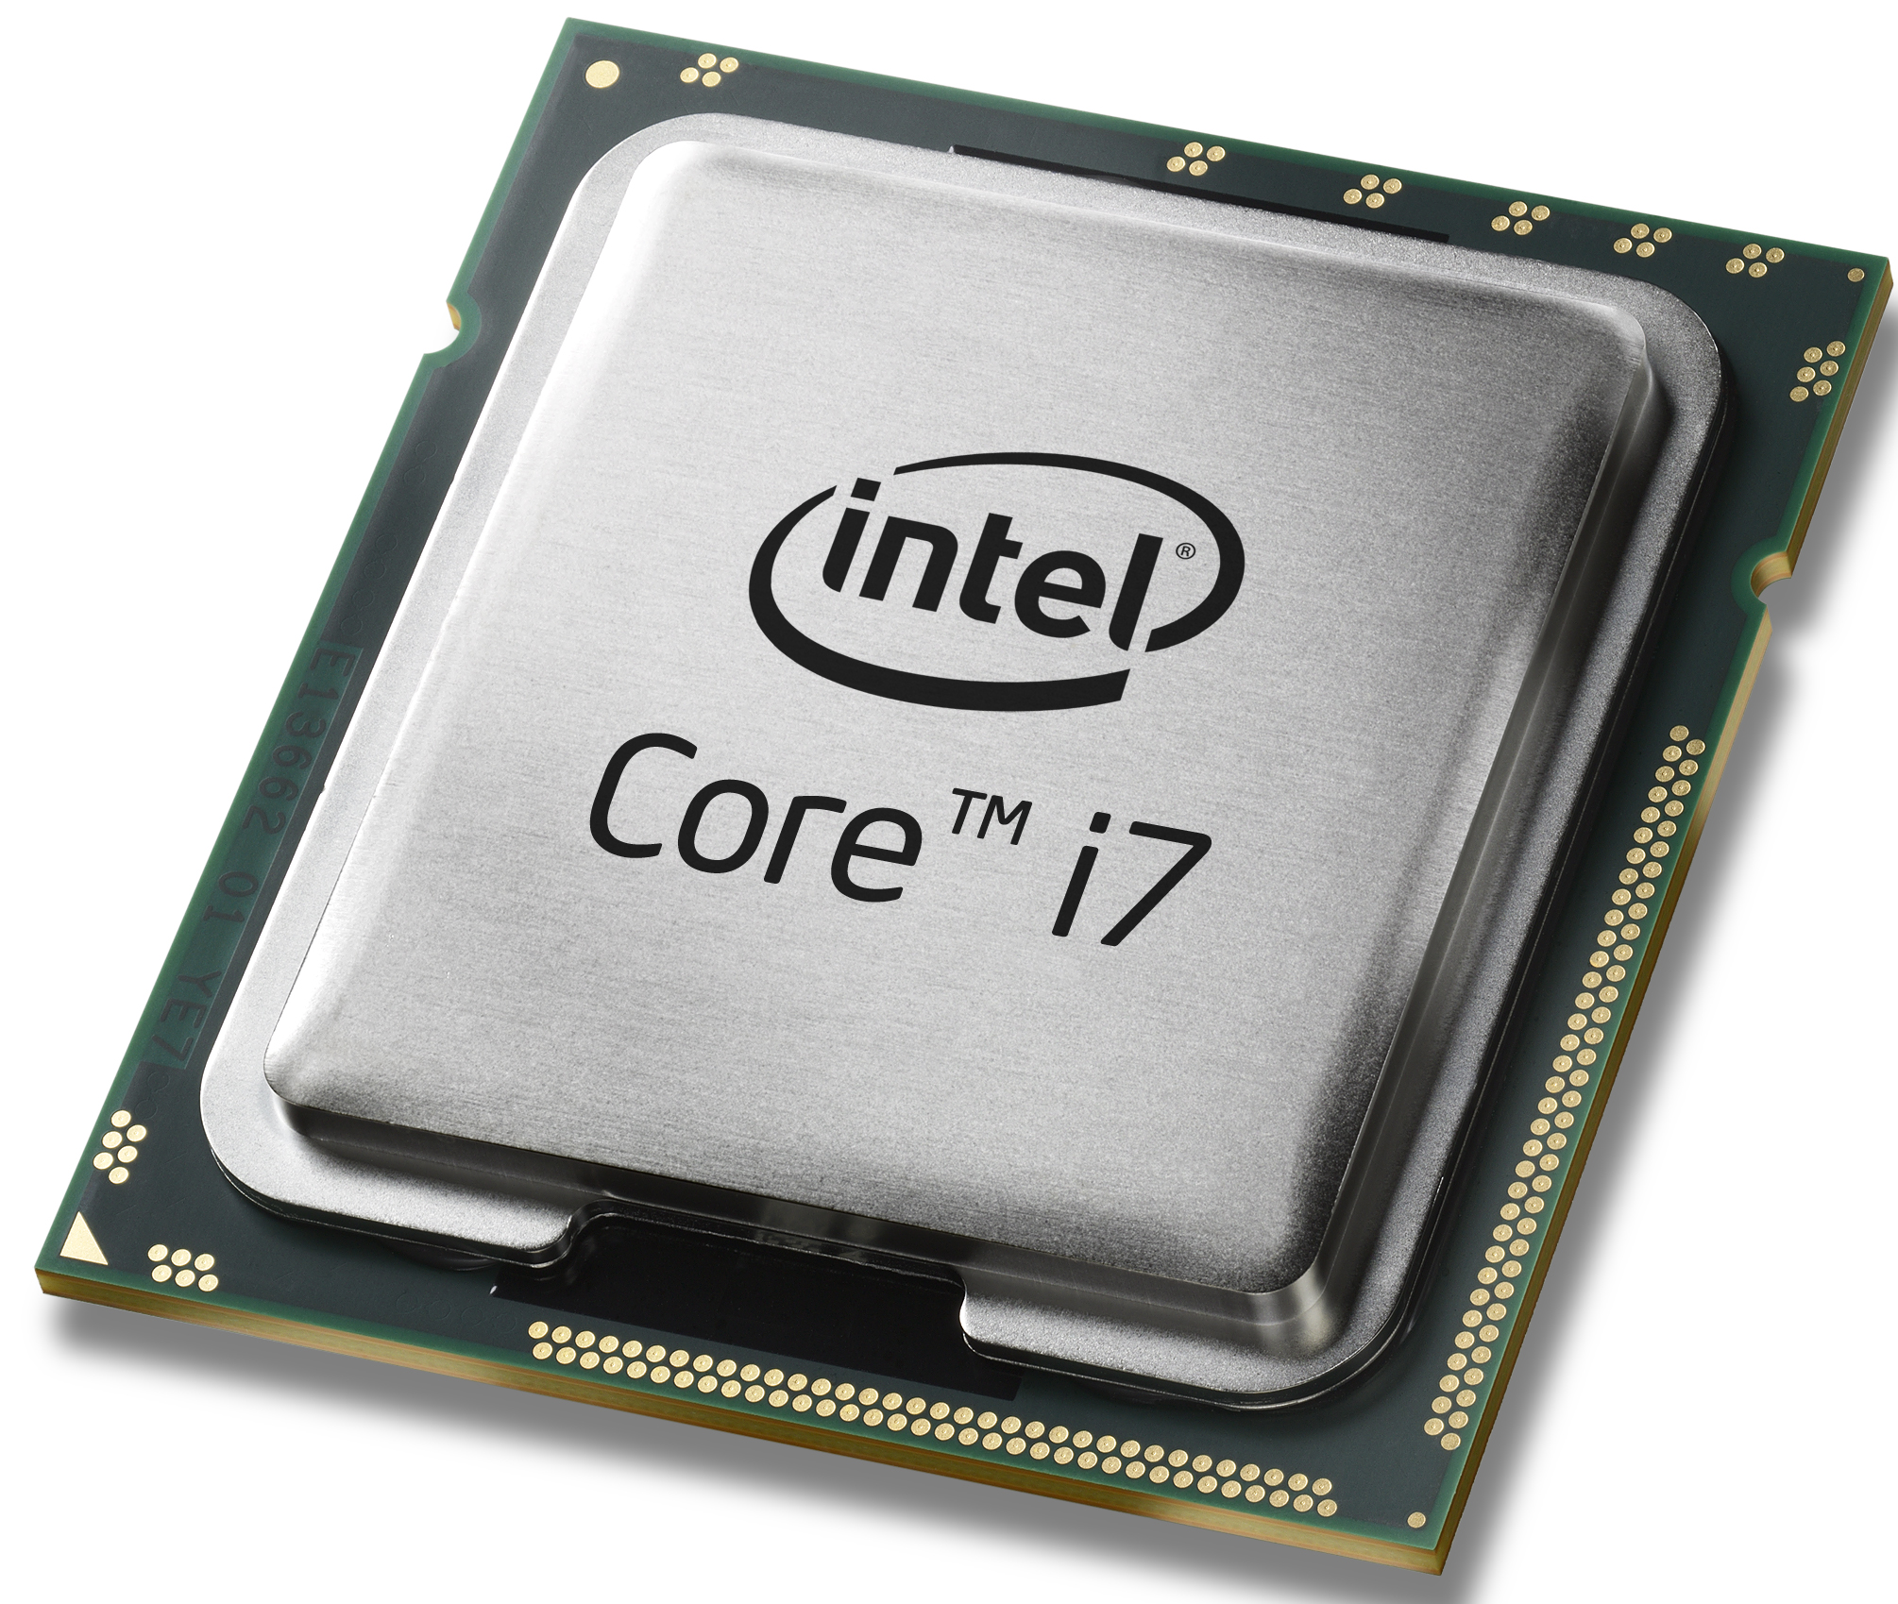
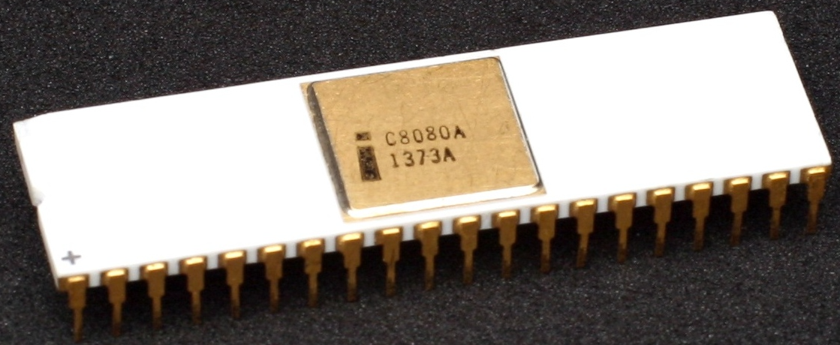
Byte
Byte: a fixed size group of bits
The term is coined by Werner Buchholz (IBM).
Long long ago, different vendors use different byte sizes
Now: Byte is 8-bit
IBM System/360, 1964
Intel 8080, 1974
Modern processors
Introduced 8-bit byte
Widely adopted
Standardized
Notes:
Why byte?

Slide 16
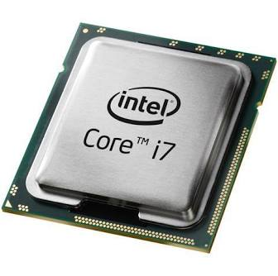
Byte
00011010
00001110
11001010
10101110
00111010
......
Memory
CPU
Byte is the smallest unit of information storage, computation and transfer
Integers are represented by 1,2,4, or 8 bytes.
Notes:
Why byte?

Slide 17
Range of 1-byte non-negative integers: [0, ??]
Bit-pattern of the largest integer?

Slide 18
Range of 4-byte non-negative integers: [0, ??]

Slide 19
Most and least significant bit
MSB: bit position with the largest positional value
LSB: bit position with the smallest positional value
1-byte unsigned int:
10011010
4-byte unsigned int:
01110011 10001101 01010011 11011010
Most significant byte
Most significant byte

Slide 20
What we’ve learnt so far
Digital information is represented in bits
Byte = 8 bits
Base2 representation of unsigned integers:
1-byte range: [0, 2⁸-1]
4-byte range: [0, 2³²-1]
b_{n-1}b_{n-2}…b₂b₁b₀ =

Slide 21
Describing bit patterns in a human-readable way
1-byte int: 10101110
C program:
unsigned int a = 0b10101110;
If I ask you to type a 4-byte int, …

Slide 22
Describing a bit pattern- Hex Notation
Hex “digit” consists of 16 symbols
0-9, a,b,c,d,e,f
Decimal
Binary
Hex
0
0
0000
1
1
0001
2
2
0010
How many bits are needed
to represent a hex symbol?
3
3
0011
4
4
0100
5
5
0101
6
6
0110
7
7
0111
8
8
1000
9
9
1001
A
10
1010
B
11
1011
C
12
1100
D
13
1101
E
14
1110
F
15
1111

Slide 23

Breakout time!

Slide 24
Lesson plan
How computers represent integers
Bit, Byte
Hex notation
How computers add/subtract integers
Unsigned vs. signed integer representation

Slide 25



Unsigned int addition
0 0 0 0 1 0 1 1
+
0 0 0 0 1 0 1 0
0 0 0 1 0 1 0 1

Slide 26

Unsigned int addition
1 0 0 0 1 0 1 1
+
1 0 0 0 1 0 1 0
0 0 0 1 0 1 0 1
Overflow!

Slide 27
Unsigned subtraction
0 0 0 0 1 1 1 0
-
0 0 0 0 1 0 1 1
0 0 0 0 0 0 1 1

Slide 28
Unsigned subtraction
0 0 0 0 1 0 1 0
-
0 0 0 0 1 0 1 1
1 1 1 1 1 1 1 1
Overflow!

Slide 29
Question:
How to represent negative numbers?

Slide 30
Strawman
Most significant bit (MSB) represents the sign
0 0 0 0 0 0 0 1₂
1
1 0 0 0 0 0 0 1₂
-1
0 0 0 0 0 0 0 1
+
1 0 0 0 0 0 0 1

Slide 31

Strawman
Most significant bit (MSB) represents the sign
0 0 0 0 0 0 0 1₂
1
sign
magnitude
1 0 0 0 0 0 0 1₂
-1
0 0 0 0 0 0 0 1
+
1 0 0 0 0 0 0 1
1 0 0 0 0 0 1 0
-2 ???

Slide 32
Two’s complement
Unsigned int
00010110
= 0*2⁷ + 0*2⁶ + 0*2⁵ + 1*2⁴ + 0*2³ + 1*2² + 1*2¹ + 0*2⁰
10010110
= 1*2⁷ + 0*2⁶ + 0*2⁵ + 1*2⁴ + 0*2³ + 1*2² + 1*2¹ + 0*2⁰
Signed int
00010110
= 0*2⁷ + 0*2⁶ + 0*2⁵ + 1*2⁴ + 0*2³ + 1*2² + 1*2¹ + 0*2⁰
10010110
= -1*2⁷ + 0*2⁶ + 0*2⁵ + 1*2⁴ + 0*2³ + 1*2² + 1*2¹ + 0*2⁰

Slide 33
Two’s complement
1-byte bit pattern → signed int
Bit pattern | value
00000000 | 0
00000001 | 1
… | …
01111111 | 2⁷-1 = 127
10000000 | 2⁻⁸ = -128
10000001 | 2⁻⁸ +1= -127
…
11111111 | 2⁻⁸+(2⁷-1) = -1

Slide 34
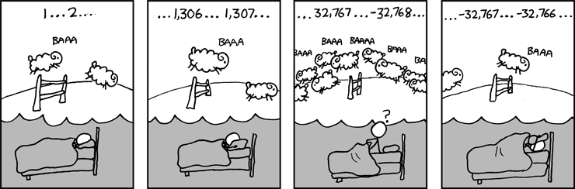
Two’s complement
1-byte bit pattern → signed int
Source: xkcd.com

Slide 35
Basic facts of 2’s complement
Signed int
Size (bytes) | Bit pattern of smallest | Bit pattern of largest | Range
1
2
4
8
0x80 | 0x7f | [-2⁻⁷, 2⁷-1]
0x8000 | 0x7fff | [-2⁻¹⁵, 2¹⁵-1]
0x80000000 | 0x7fffffff | [-2⁻³¹, 2³¹-1]
0x8000000000000000 | 0x7fffffffffffffff | [-2⁻⁶³, 2⁶³-1]
🤔 Home exercise: make a similar table for unsigned int
Negative numbers ←→ MSB=1
A sequence of 1’s (e.g. 0xff, 0xffffffff) ←→ -1

Slide 36
Signed addition on hardware
🤔
0 0 0 0 0 0 0 1
(1)₁₀
(3)₁₀
0 0 0 0 0 0 0 1
(1)₁₀
(-127)₁₀
This is what 2’s complement is designed to accomplish!
+
+
0 0 0 0 0 0 1 1
1 0 0 0 0 0 0 1
(4)₁₀
(-126)₁₀
0 0 0 0 0 1 0 0
1 0 0 0 0 0 1 0
0 1 0 0 0 0 0 1
(65)₁₀
(64)₁₀
1 0 0 0 0 0 0 1
(-127)₁₀
(-2)₁₀
+
+
1 1 1 1 1 1 1 0
0 1 0 0 0 0 0 0
(-127)₁₀
(1)₁₀
1 0 0 0 0 0 0 1
0 0 0 0 0 0 0 1
Overflow!

Slide 37
Signed subtraction on hardware
🤔
0 0 0 0 0 0 0 1
(1)₁₀
(3)₁₀
0 0 0 0 0 0 0 1
(1)₁₀
(-1)₁₀
-
-
0 0 0 0 0 0 1 1
1 1 1 1 1 1 1 1
This is what 2’s complement is designed to accomplish!
(-2)₁₀
(2)₁₀
1 1 1 1 1 1 1 0
0 0 0 0 0 0 1 0
0 1 1 1 1 1 1 1
(127)₁₀
(-2)₁₀
1 0 0 0 0 0 0 0
(-128)₁₀
(1)₁₀
-
-
0 0 0 0 0 0 0 1
1 1 1 1 1 1 1 0
(-127)₁₀
(127)₁₀
1 0 0 0 0 0 0 1
0 1 1 1 1 1 1 1
Overflow!

Slide 38
Summary
Integer representation
Unsigned (base-2)
Signed (2’s complement)
Hex notation
Operations (e.g. add,subtract) on fixed-width integers can cause overflow

